Slide 1
Java 8 Features
Functional Interface (SAM – Single Abstract Method)
Default & Static Methods in interface
Pre-defined Functional Interfaces
Functions
Suppliers
Consumers
Predicates
Comparators
Optionals
Lamda Expression
:: Operator (Method Reference & Constructor Reference)
Optional Class
Stream API
Source
Filter
Sort
Map
Collect
Parallel Streams
Sequential Sort
Parallel Sort
Map
Collectors Class
forEach method
Iterator
Stream

Slide 2
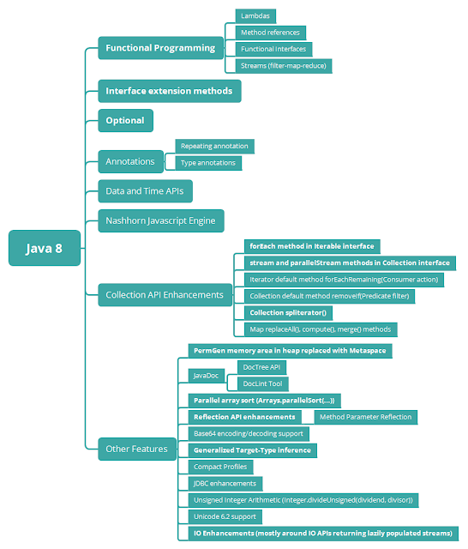
Key Features of Java 8

Slide 3
1. Functional Interface (SAM – Single Abstract Method)
Functional interface is an interface that specifies exactly one abstract method.
Functional Interface is also known as Single Abstract Method Interfaces or SAM Interfaces. It is a new feature in Java 8, which helps to achieve a functional programming approach.
A functional interface can extend another interface only when it does not have any abstract method.
The Java API has many one-method interfaces such as Comparator, Runnable, Callable, ActionListener etc. They can be implemented and instantiated using anonymous class syntax.
It can have any number of default, static methods but can contain only one abstract method. It can also declare the methods of the object class.

Slide 4
Function Interface
A Function is a functional interface whose sole purpose is to return any result by working on a single input argument.
It represents a function that accepts one argument and returns a result.
The function interface contains exactly one abstract method apply(T t).
Note that it also contains default, static methods.

Slide 5
Consumer Interface
It represents an operation that accepts a single argument and returns no result.
The consumer interface contains exactly one abstract method accept(T arg0).
Hence we can apply lambda expression to it.
It is an Functional interface.

